Slide 1
Building construction
Contents :
Foundation & it’s types
Stairs & it’s classification
Masonry & it’s types
Building & it’s classification
Doors and windows & it’s types

Slide 2
Foundation
A foundation is a lower portion of building structure that transfers its gravity loads to the earth. Foundations are generally broken into two categories: shallow foundations and deep foundations. A tall building must have a strong foundation if it is to stand for a long time.

Slide 5
Types Of Foundation
1.Shallow Foundation
It is further classified into:
Wall footing
Isolated footing
Combined footing
Raft footing
Inverted arch footing
Grillage footing
2.Deep Foundation
It is further classified into:
Pile Foundation
Well Foundation

Slide 6
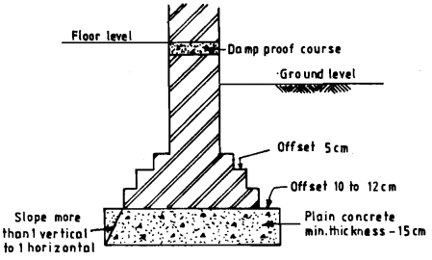
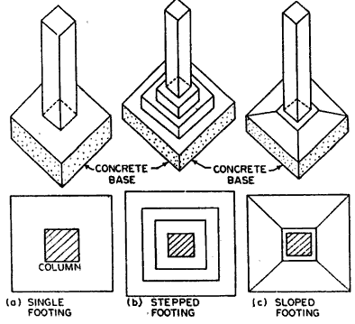
Wall footing
Isolated footing

Slide 7
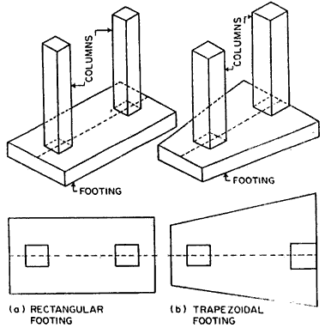
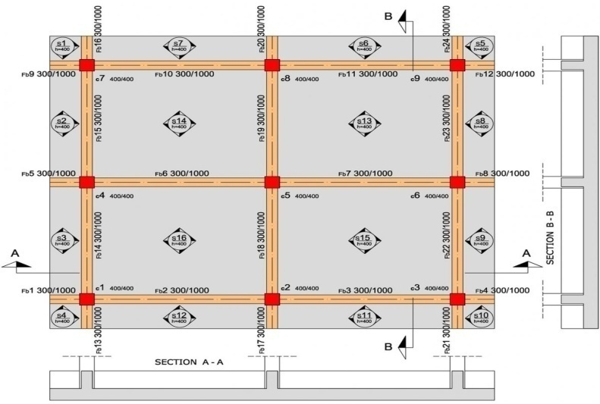
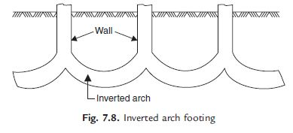
Combined footing
Raft footing
Inverted arch footing

Slide 8
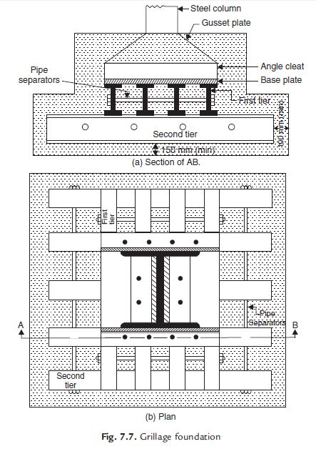
Grillage footing

Slide 9
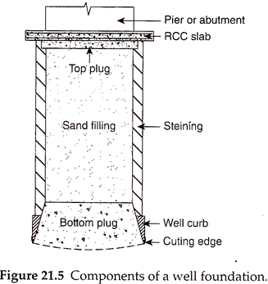
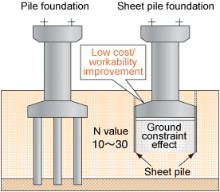
Types of Deep Foundation
Pile Foundation
Well Foundation

Slide 10
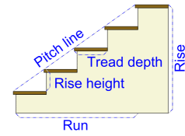
Stairs
A stairway, staircase, stairwell, flight of stairs, or simply stairs is a construction designed to bridge a large vertical distance by dividing it into smaller vertical distances, called steps. Stairs may be straight, round, or may consist of two or more straight pieces connected at angles.
Various Components or Parts of Staircase and their Details
Following are the various components of staircase:
Step
The step is composed of the tread and riser.
Tread The tread “depth” is measured from the outer edge of the step to the vertical “riser” between steps. The “width” is measured from one side to the other.
Riser
The vertical portion between each tread on the stair. This may be missing for an “open” stair effect.

Slide 11
Landing – A landing is the area of a floor near the top or bottom step of a stair. An intermediate landing is a small platform that is built as part of the stair between main floor levels and is typically used to allow stairs to hange directions, or to allow the user a rest.
Staircase – the entire structure relating to a stair, comprising steps, treads, risers, strings, balustrading, landings etc
FLIGHT
It is a series of steps without any platform or landing or break in their direction.
GOING
It is the horizontal distance between two successive riser faces.
NOSING
This is the outer projecting edge of a tread. This is generally made rounded to give more pleasing appearance and makes the staircase easy to navigate
WINDERS
They are tapering steps used for changing the direction of a stair.
SCOTIA
It is a moulding provided under the nosing to improve the elevation of the step, and to provide strength to nosing.
PITCH OR SLOPE
It is angle which the line of nosing of the stair makes with the horizontal.

Slide 12
STRINGS OR STRINGERS
These are the sloping members which support the steps in a stair. They run along the slope of the stair.
BALUSTER
It is a vertical member of wood or metal, supporting the hand rails.
HAND RAIL
It is a rounded or moulded member of wood or metal following generally the contour of the nosing line, and fixed on the top of balusters.
RUN
It is the total length of stair in a horizontal plane, including landings.
HEADER
It is the horizontal structural member supporting stair stringers or landings.

Slide 13
Requirement Of a Good Stair
1. LOCATION
It should preferably be located centrally, ensuring sufficient light and ventilation.
2. WIDTH OF STAIR
The width of stairs for public buildings should be 1.8 m and for residential buildings 0.9 m.
3. LENGTH
The flight of the stairs should be restricted to a maximum of 12 and minimum of 3 steps.
4. PITCH OF STAIR
The pitch of long stairs should be made flatter by introducing landing. The slope should not exceed 400 and should not be less than 250.
5. HEAD ROOM
The distance between the tread and soffit of the flight immediately above it, should not be less than 2.1 to 2.3 m. This much of height is maintained so that a tall person can use the stairs with some luggage on its head.
6. MATERIALS
Stairs should be constructed using fire resisting materials. Materials also should have sufficient strength to resist any impact.

Slide 14
7. BALUSTRADE
All open well stairs should be provided with balustrades, to avoid accidents. In case of wide stairs it should be provided with hand rails on both sides.
8. LANDING
The width of the landing should not be less than the width of the stair.
9. WINDERS
These should be avoided and if found necessary, may be provided at lower end of the flight.
10. STEP PROPORTIONS
The ratio of the going and the rise of a step should be well proportioned to ensure a comfortable access to the stair way.

Slide 15
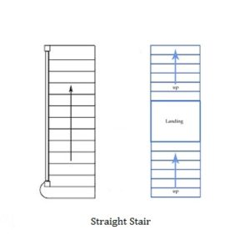
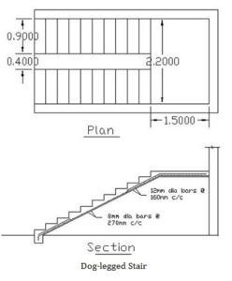
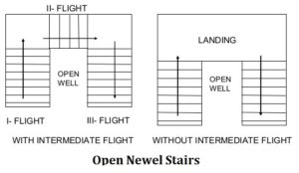
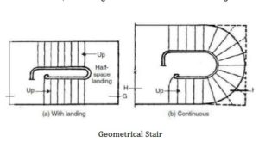
CLASSIFICATION OF STAIRS
1. STRAIGHT STAIR:
2. DOGGED-LEGGED STAIR:
3. OPEN NEWEL STAIR:
4. GEOMETRICAL STAIR:

Slide 16
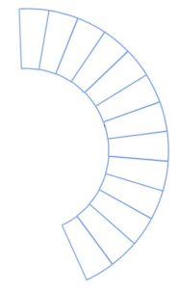
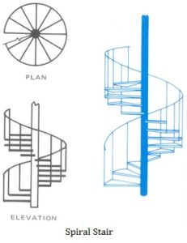
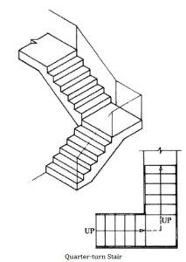
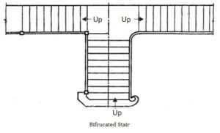
5. CIRCULAR STAIR:
6. SPIRAL STAIR:
7. QUARTER-TURN STAIR:
8. BIFURCATED STAIR:

Slide 17
Masonry
Masonry consists of building structures by laying individual masonry units (brick, concrete block, stone, etc). Normally the masonry units are laid with cement mortar, which binds them together to create a structure. Masonry construction can provide beautiful walls and floors at economical prices.
Brick masonry
Brick masonry is used for construction of buildings and other structures by using brick stone, stone blocks, brick blocks with different types of masonry.

Slide 18
Application of the Brick Masonry
Brick masonry has a number of practical application and can be used very conveniently at places like construction of ordinary as well as important
building ,foundation,walls,columns,ornamental works ,circular brick work
buttresses, retaining structures, window sills, jambs, corbels, coping, fire places, flumes, tall chimney,cavity walls,floors,arches,culverts,steps,etc.
Advantages of Brick masonry
Since shape and size of bricks are uniform, it do not need skilled labour for the construction.
Bricks are light in weight and hence handling them is easy.
Bricks are easily available around cities and their transportation cost is less because their weight is less.
It is possible to use all types of mortar in brick masonry.
Thinner walls can be constructed with bricks but it is not so with stones.
It is easy to form openings for doors and windows.
Dead load of brick masonry is less.
Brick masonry has better fire and weather resistance compared to stone masonry.

Slide 19
TECHNICAL TERMS USED IN MASONRY WORKS
1. HEADER:
It is a full brick or stone which is laid with its length perpendicular to the face of the wall.
2. STRETCHER:
It is a full brick or stone in which is laid its length parallel to the face of the wall.
3. BOND:
It is a term applied to the overlapping of bricks or stones in a wall in alternate courses, to bind the whole wall together.
4. COURSE:
A horizontal layer of bricks or stones is termed as course.
5. HEADER COURSE:
It is a course of brickwork entirely composed of headers.
6. STRETCHER COURSE:
It is a course of brickwork in which all the bricks are laid as stretchers.
7. BED:
It is a term used to indicate the lower surface of bricks or stones in each course. It may also be termed as surface of the bricks on which it rests.
8. FACE:
The surface of a wall exposed to weather is termed as face.
9. FACING:
The material used in the face of the wall is known as facing.
10. BACK:
The inner surface of the wall which is not exposed to the weather is termed as back.
11. BACKING:
The material used in forming the back of the wall is known as backing.
12. HEARTING:
The portion of a wall between facing and backing is termed as hearting.

Slide 20
13. JOINT:
The junction of two or more bricks or stones is called joint.
14. RACKING BACK:
The process of stopping the unfinished end of a wall in stepped fashion.
15. BAT:
It is a portion of a brick cut across the width or a brick cut by some fraction of its length.
16. CLOSER:
It is a portion of a brick cut in such a manner that its one long face remains uncut.
17. KING CLOSER:
It is a brick which is cut in such a way that the width of one of its end is half that of a full brick.
18. QUEEN CLOSER:
It is a term applied to a brick which is half as wide as full brick. Queen closer is made by cutting a brick lengthwise into two portions.
19. BEVELLED CLOSER:
It is similar to king closer with the only difference that the whole length of the brick is bevelled for maintaining half width at one end and full width at the other.
20. MITRED CLOSER:
It is a brick whose one end is cut splayed or mitred for the full width.
21. PERPEND:
It is a vertical joint on the face of a wall directly over vertical joints in an alternate course.
22. FROG:
It is a depression on the top face of a brick. Frog provides a recess for the mortar which on setting forms a key and prevents the displacement of the brick above.
23. PLINTH:
The horizontal projecting or flush course of stone or brick provided at the base of the wall above ground level is known as plinth.

Slide 21
24. SILL:
It is a horizontal member of brick, stone, concrete or wood provided to give support for the vertical members of a window.
25. JAMBS:
The vertical sides of a finished opening for door, window or fire place etc. are termed as jambs.
26. REVEALS:
Reveals are the exposed vertical surfaces left on the sides of an opening after the door or window frame has been fitted in position.
27. LINTEL:
A horizontal member of stone, brick, steel or RCC, used to support the masonry or load above an opening.
28. ARCH:
A mechanical arrangement of wedge-shaped blocks of stone or brick arranged in the form of a curve supporting the masonry or load above an opening.
29. CORNICE:
It is a horizontal moulded projection provided near the top of a building or at the junction of a wall and ceiling.
30. PARAPET:
It is a term applied to a low wall built around a flat roof to act as a protective solid balustrade for the users of the terrace.
31. WEATHERING:
Weathering is the term applied to the bevelled top surface of a stone.
32. GABLE:
It is a triangular shaped portion of masonry at the end of a sloped roof.
33. SPALLS:
Chips or small pieces of stone broken off a large block are termed as spalls.

Slide 22
34. COLUMNS:
It is an isolated vertical load bearing member whose width does not exceed four times its thickness.
35. PIER:
It is a vertical member of stone or brick masonry constructed to support an arch, beam or lintel etc.
36. BUTTRESS:
It is similar to pier built on the exterior of a wall properly bonded to it.
37. CORBEL:
It is the extension of one or more course of brick or stone from the face of a wall.
38. THRESHOLDS:
The arrangement of steps provided from ground level to reach plinth level on external doors and verandah is termed as thresholds.
Types of Bonds in Brick Masonry Wall Construction :
The most commonly used types of bonds in brick masonry are:
Stretcher bond
Header bond
English bond
Flemish bond
Dutch bond
6.English cross bond
7.Brick on edge bond
8.Raking bond
9.Facing bond
10.Garden wall bond

Slide 23
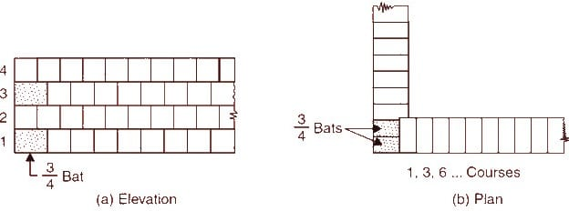
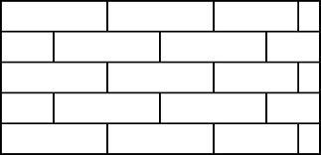
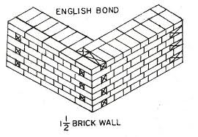
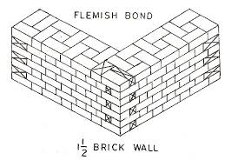
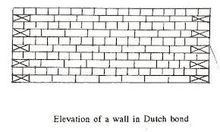
1.Stretcher bond
2. Header bond
3. English bond
4. Flemish bond
5.Dutch bond

Slide 24
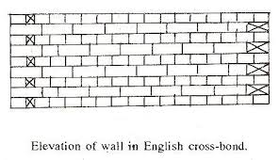
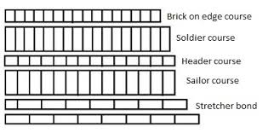
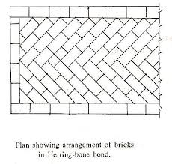
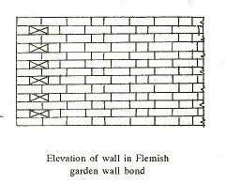
6.English cross bond
7.Brick on edge bond
8.Raking bond
10.Garden wall bond

Slide 25
Stone masonry
The art of building the structures using stone blocks and mortar is termed as
stone masonry is preferred where building stones are abundantly available
in nature .These stones when cut and dressed to proper shape and size provide an economical material for the construction of various parts of the building in hilly terrains.
Glossary of terms
Natural Bed: The setting of the stone on the same plane as it was formed in the ground. This generally applies to all stratified materials.
Bed: The top or bottom of a joint; natural bed-surface of stone parallel to its stratification.
3. Bedding plane. The plane along which a stone can be separated, easily, is called
bedding plane. Stones are laid in a structure so that load acts perpendicular to their
bedding plane.
4. Cornice. The course of a masonry provided at ceiling level of the roof projecting outside
the surface of the wall of a building, is called cornice.
5. Throating. A small groove cut on the underside of a projecting chuajja, cornice, coping,
to discharge rain water without trickling to walls, is called throating.
6. Coping: A flat stone used as a cap on walls or around the perimeter of patios and pool decks.
7. Template: A detailed pattern or drawing showing exact dimensions to be fabricated.
8.Bond stones: Bond stones are generally cut to twice the bed thickness of the material being used.
9. Reveals. The exposed vertical surfaces perpendicular to window or door frame, are
called reveals.
10. Drip stone. A projecting dressed stone having its undersurface throated, is called drip
stone.

Slide 26
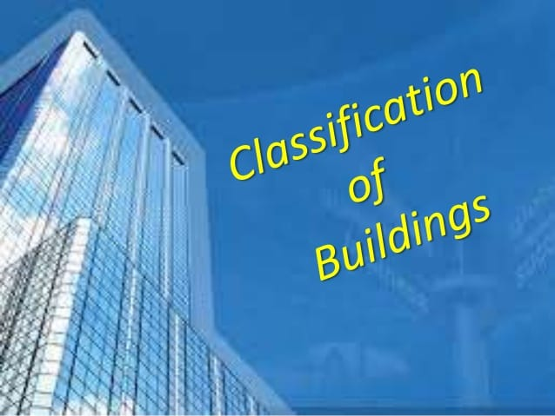

Slide 44
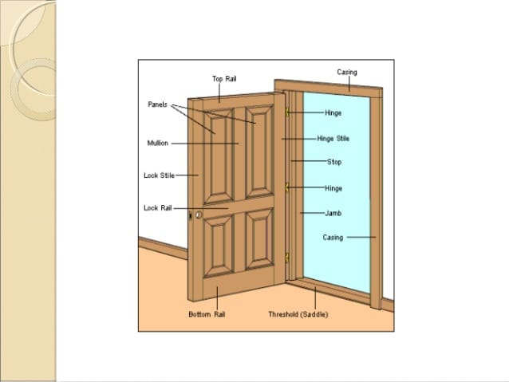

Slide 50
